Slide 1
Using Vitis HLS
XUP

Slide 2
Objectives
After completing this module, you will be able to:
List various OS under which Vitis HLS is supported
Describe how projects are created and maintained in Vitis HLS
State various steps involved in using Vitis HLS project creation wizard
Distinguish between the role of top-level module in testbench and design to be synthesized
List various verifications which can be done in Vitis HLS
List Vitis HLS project directory structure

Slide 3
Outline
Invoking Vitis HLS
Project Creation using Vitis HLS
Synthesis to IPXACT Flow
Design Analysis
Other Ways to use Vitis HLS
Summary

Slide 4
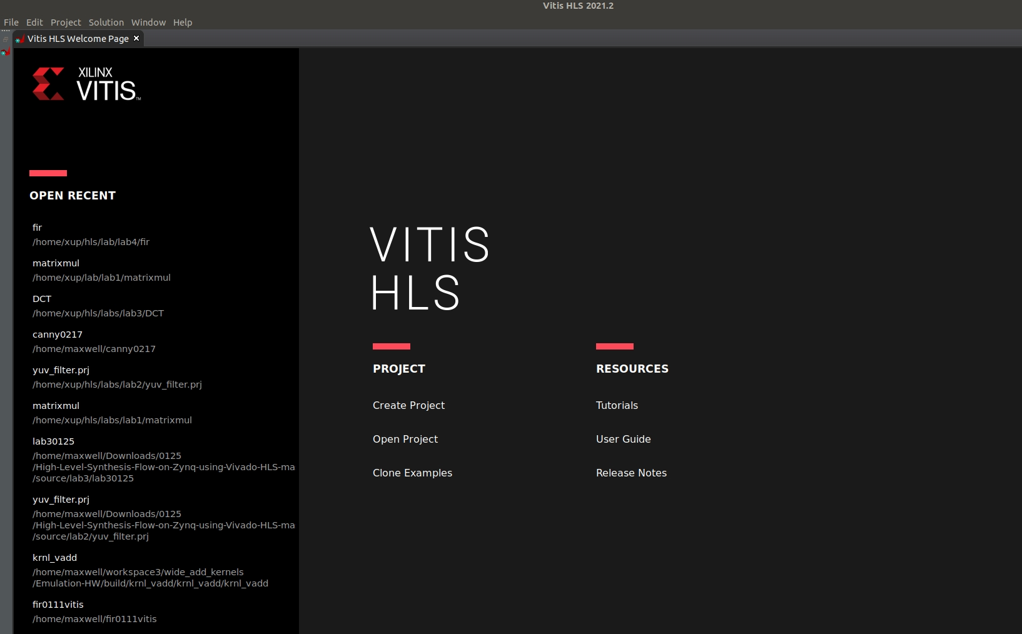
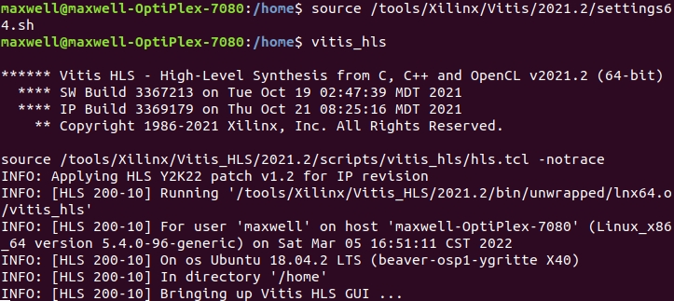
Invoke Vitis HLS from the terminal
The first step is to open or create a project
12- 4

Slide 5
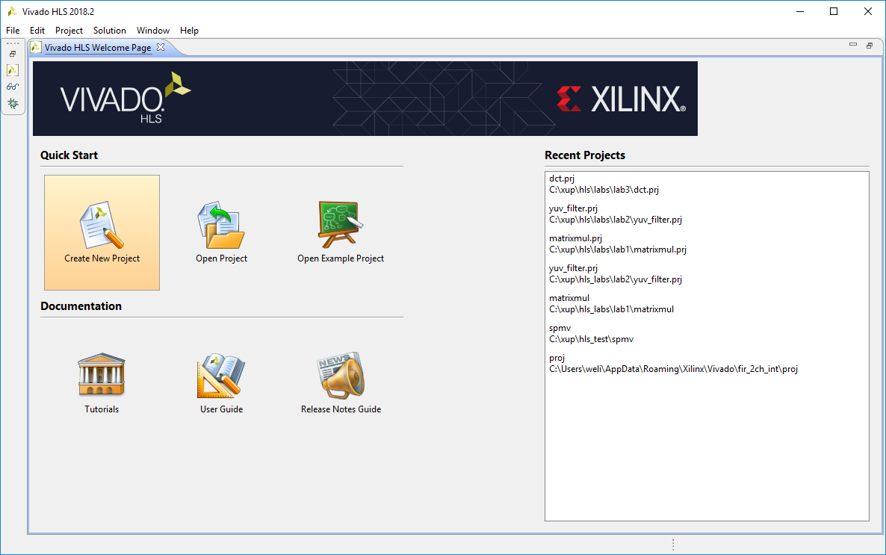
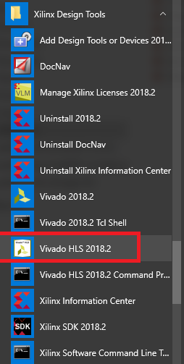
Invoke Vivado HLS from Windows Menu
The first step is to open or create a project
12- 5

Slide 6
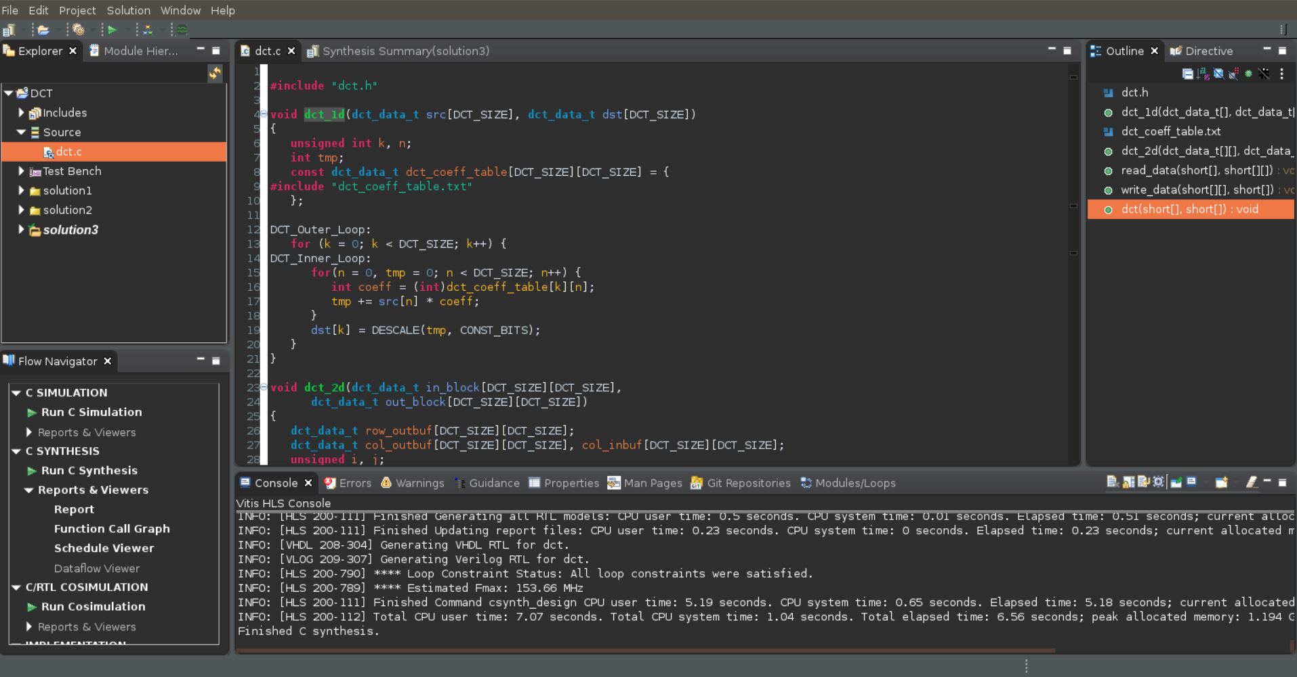
Vitis HLS GUI
Information
Pane
Auxiliary Pane
Project
Explorer
Pane
Console
Pane
12- 6

Slide 7
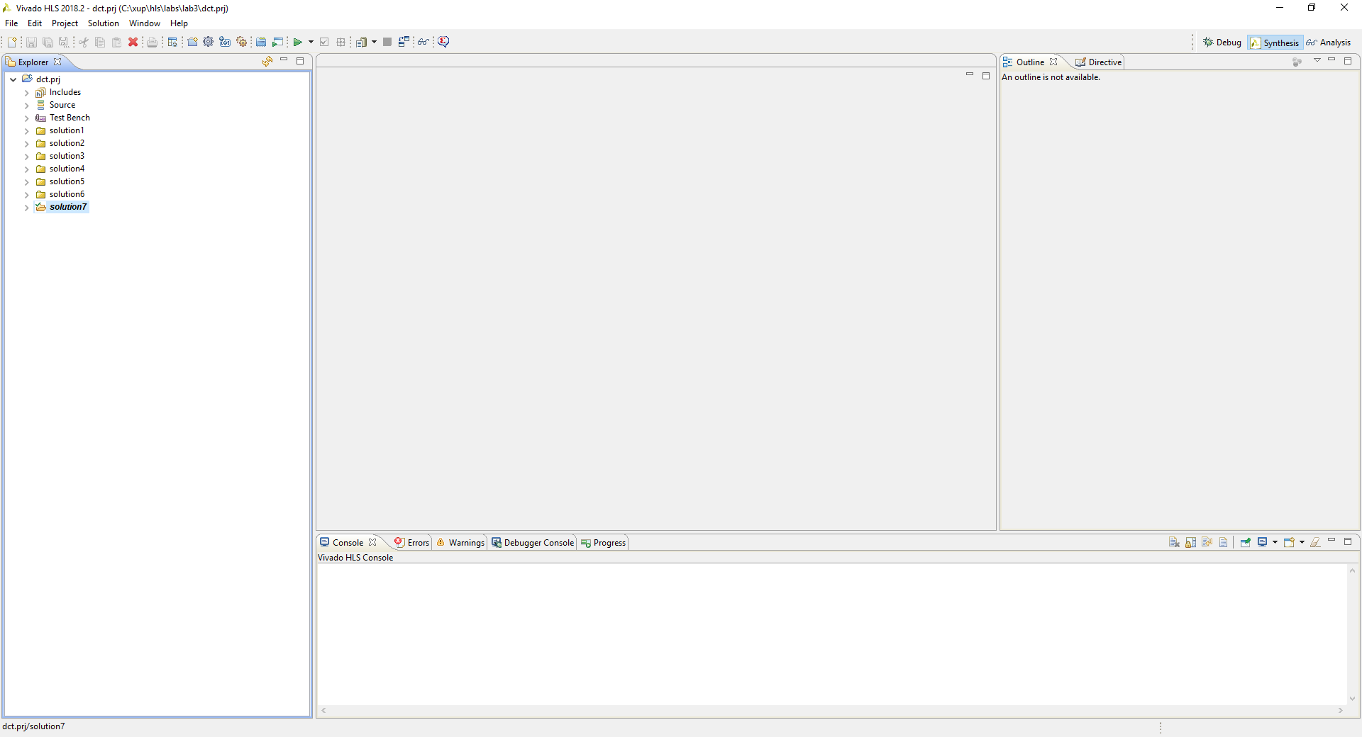
Vivado HLS GUI
Information
Pane
Auxiliary Pane
Project
Explorer
Pane
Console
Pane
12- 7

Slide 8
Project Creation using Vitis HLS

Slide 9
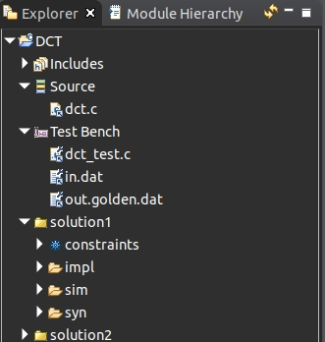
Vitis HLS Projects and Solutions
Vitis HLS is project based
A project specifies the source code which will be synthesized
Each project is based on one set of source code
Each project has a user specified name
A project can contain multiple solutions
Solutions are different implementations of the same code
Auto-named solution1, solution2, etc.
Supports user specified names
Solutions can have different clock frequencies, target technologies, synthesis directives
Projects and solutions are stored in a hierarchical directory structure
Top-level is the project directory
The disk directory structure is identical to the structure shown in the GUI project explorer (except for source code location)
Source
Project Level
Solution Level
12- 9

Slide 10
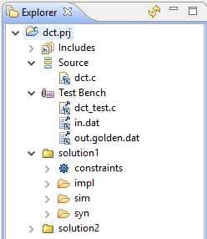
Vivado HLS Projects and Solutions
Vivado HLS is project based
A project specifies the source code which will be synthesized
Each project is based on one set of source code
Each project has a user specified name
A project can contain multiple solutions
Solutions are different implementations of the same code
Auto-named solution1, solution2, etc.
Supports user specified names
Solutions can have different clock frequencies, target technologies, synthesis directives
Projects and solutions are stored in a hierarchical directory structure
Top-level is the project directory
The disk directory structure is identical to the structure shown in the GUI project explorer (except for source code location)
Source
Project Level
Solution Level
12- 10

Slide 11
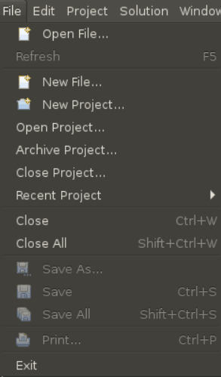
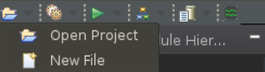
Vitis HLS Step 1: Create or Open a project
Start a new project
The GUI will start the project wizard to guide you through all the steps
Open an existing project
All results, reports and directives are automatically saved/remembered
Use “Recent Project” menu for quick access
Optionally use the Toolbar Button to
Open Project
12- 11

Slide 12
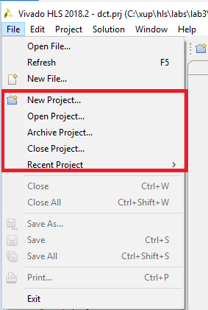
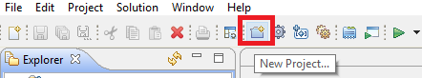
Vivado HLS Step 1: Create or Open a project
Start a new project
The GUI will start the project wizard to guide you through all the steps
Open an existing project
All results, reports and directives are automatically saved/remembered
Use “Recent Project” menu for quick access
Optionally use the Toolbar Button to
Open New Project
12- 12

Slide 13
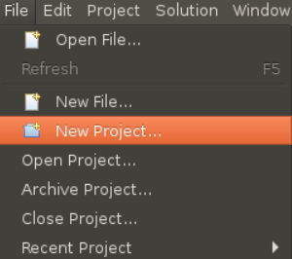
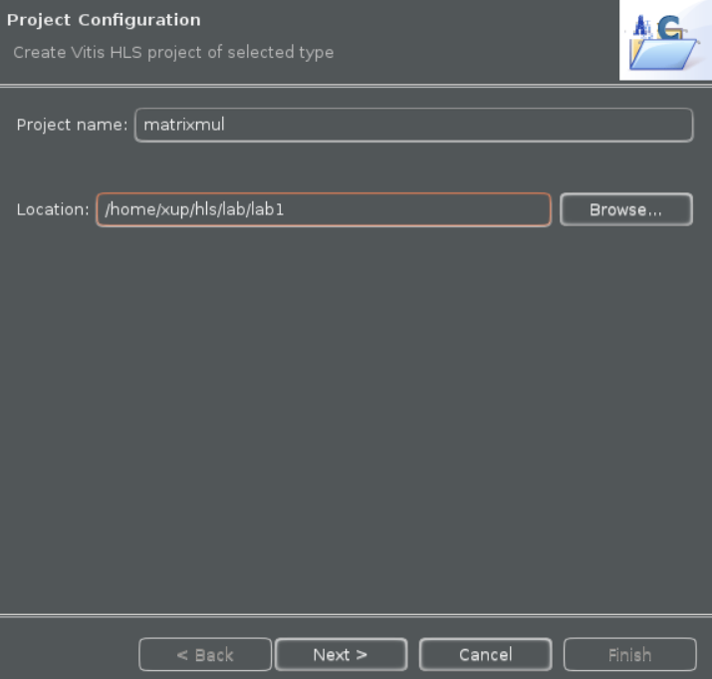
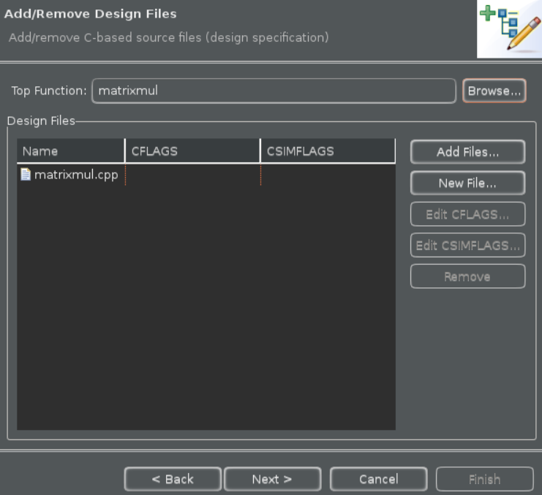
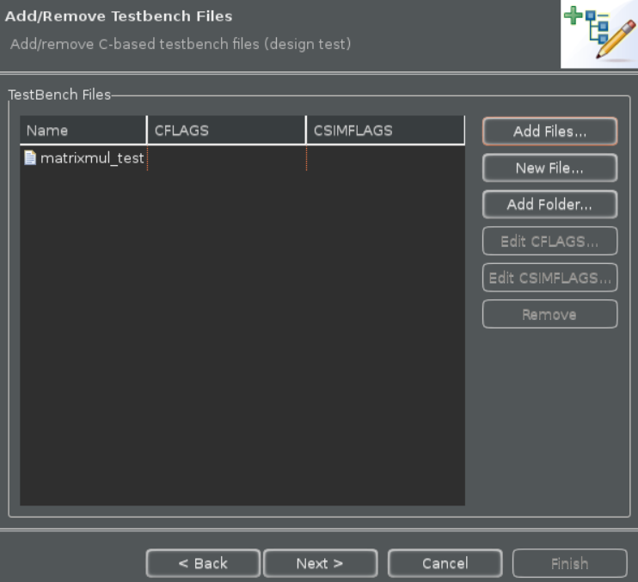
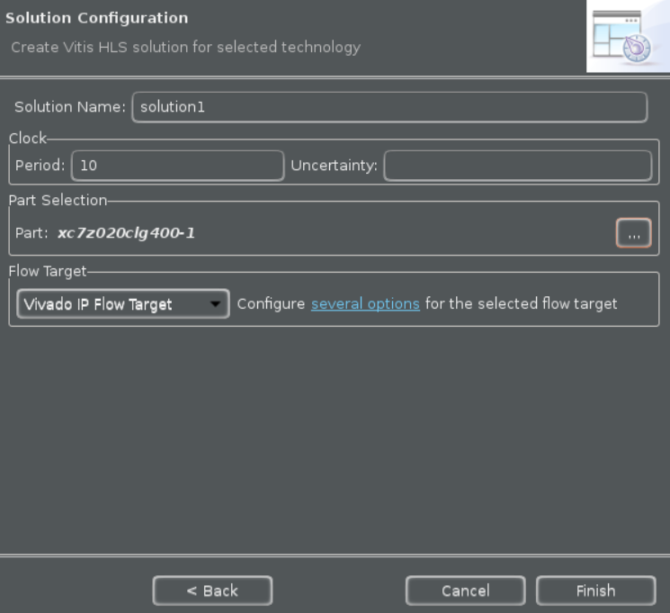
Project Wizard
The Project Wizard guides users through the steps of opening a new project
Step-by-step guide …
Define project and directory
Add design source files
Specify test bench files
Specify clock and select part
Project Level Information
1st Solution Information

Slide 14
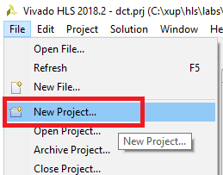
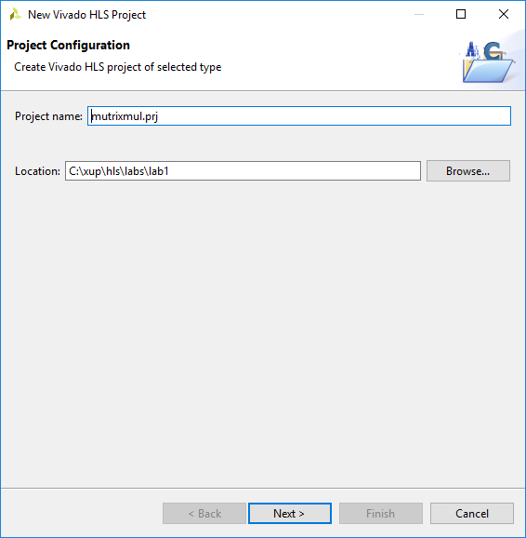
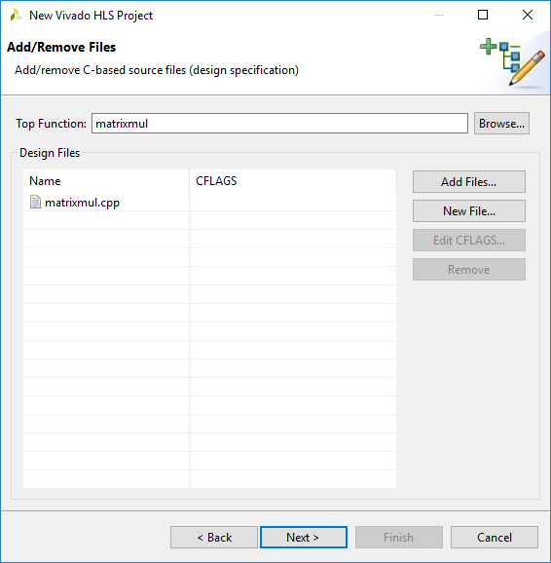
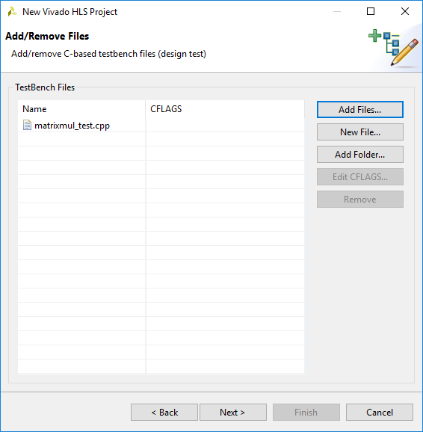
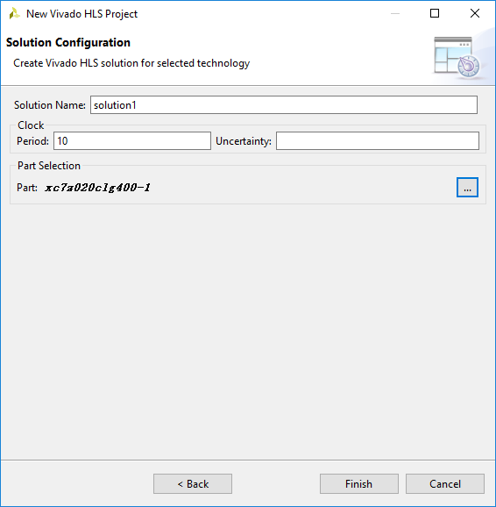
Project Wizard
The Project Wizard guides users through the steps of opening a new project
Step-by-step guide …
Define project and directory
Add design source files
Specify test bench files
Specify clock and select part
Project Level Information
1st Solution Information

Slide 15

Define Project & Directory
Define the project name
Browse to the location of the project
In this example, project directory “matrixmul” will be created inside directory “lab1”

Slide 16
Define Project & Directory
Define the project name
Note, here the project is given the extension .prj
A useful way of seeing it’s a project (and not just another directory) when browsing
Browse to the location of the project
In this example, project directory “matrixmul.prj” will be created inside directory “lab1”

Slide 17
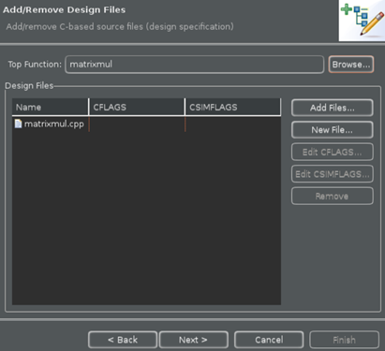
Add Design Source Files
Add Design Source Files
This allows Vitis HLS to determine the top-level design for synthesis, from the test bench and associated files
Add Files…
Select the source code file(s)
The CTRL and SHIFT keys can be used to add multiple files
No need to include headers (.h) if they reside in the same directory
Select File and Edit CFLAGS…
If required, specify C compile arguments using the “Edit CFLAGS…”
Define macros: -DVERSION1
Location of any (header) files not in the same directory as the source: -I../include
There is no need to add the location of standard Vitis HLS header files or header files located in the same project location

Slide 18
Add Design Source Files
Add Design Source Files
This allows Vivado HLS to determine the top-level design for synthesis, from the test bench and associated files
Not required for SystemC designs
Add Files…
Select the source code file(s)
The CTRL and SHIFT keys can be used to add multiple files
No need to include headers (.h) if they reside in the same directory
Select File and Edit CFLAGS…
If required, specify C compile arguments using the “Edit CFLAGS…”
Define macros: -DVERSION1
Location of any (header) files not in the same directory as the source: -I../include
There is no need to add the location of standard Vivado HLS or SystemC header files or header files located in the same project location

Slide 19
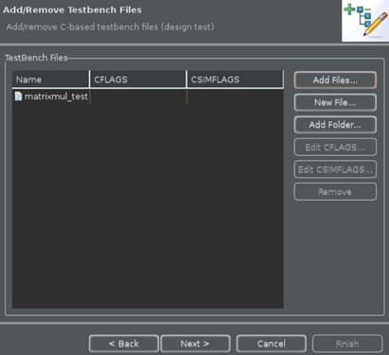
Specify Test Bench Files
Use “Add Files” to include the test bench
Vitis HLS will re-use these to verify the RTL using co-simulation
And all files referenced by the test bench
The RTL simulation will be executed in a different directory (Ensures the original results are not over-written)
Vitis HLS needs to also copy any files accessed by the test bench
E.g. Input data and output results
Add Folders
If the test bench uses relative paths like “sub_directory/my_file.dat” you can add “sub_directory” as a folder/directory
Use “Edit CFLAGS…”
To add any C compile flags required for compilation

Slide 20
Specify Test Bench Files
Use “Add Files” to include the test bench
Vivado HLS will re-use these to verify the RTL using co-simulation
And all files referenced by the test bench
The RTL simulation will be executed in a different directory (Ensures the original results are not over-written)
Vivado HLS needs to also copy any files accessed by the test bench
E.g. Input data and output results
Add Folders
If the test bench uses relative paths like “sub_directory/my_file.dat” you can add “sub_directory” as a folder/directory
Use “Edit CFLAGS…”
To add any C compile flags required for compilation

Slide 21
Test benches I
The test bench should be in a separate file
Or excluded from synthesis
The Macro __SYNTHESIS__ can be used to isolate code which will not be synthesized
This macro is defined when Vitis HLS parses any code (-D__SYNTHESIS__)
// test.c
#include <stdio.h>
void test (int d[10]) {
int acc = 0;
int i;
for (i=0;i<10;i++) {
acc += d[i];
d[i] = acc;
}
}
#ifndef __SYNTHESIS__
int main () {
int d[10], i;
for (i=0;i<10;i++) {
d[i] = i;
}
test(d);
for (i=0;i<10;i++) {
printf("%d %d\n", i, d[i]);
}
return 0;
}
#endif
Design to be synthesized
Test Bench
Nothing in this ifndef will be read by Vitis HLS
(will be read by gcc)

Slide 22
Test benches II
Ideal test bench
Should be self checking
RTL verification will re-use the C test bench
If the test bench is self-checking
Allows RTL Verification to be run without a requirement to check the results again
RTL verification “passes” if the test bench return value is 0 (zero)
Actively return a 0 if the simulation passes
Non-synthesizable constructs may be added to a synthesize function if __SYNTHESIS__ is used
int main () {
// Compare results
int ret = system("diff --brief -w test_data/output.dat test_data/output.golden.dat");
if (ret != 0) {
printf("Test failed !!!\n", ret); return 1;
} else {
printf("Test passed !\n", ret); return 0;
}
The –w option ensures the “newline” does not cause a difference between Windows and Linux files
#ifndef __SYNTHESIS__
image_t *yuv = (image_t *)malloc(sizeof(image_t));
#else // Workaround malloc() calls w/o changing rest of code
image_t _yuv;
#endif

Slide 23
Solution Configuration
Provide a solution name
Default is solution1, then solution2 etc.
Specify the clock
The clock uncertainty is subtracted from the clock to provide an “effective clock period”
Vitis HLS uses the “effective clock period” for Synthesis
Provides users defined margin for downstream RTL synthesis, P&R
Select the part
Select a device family after applying filters such as family, package and speed grade (see next slide) or a board after applying boards specify

Slide 24
Solution Configuration
Provide a solution name
Default is solution1, then solution2 etc.
Specify the clock
The clock uncertainty is subtracted from the clock to provide an “effective clock period”
Vivado HLS uses the “effective clock period” for Synthesis
Provides users defined margin for downstream RTL synthesis, P&R
Select the part
Select a device family after applying filters such as family, package and speed grade (see next slide) or a board after applying boards specify

Slide 25
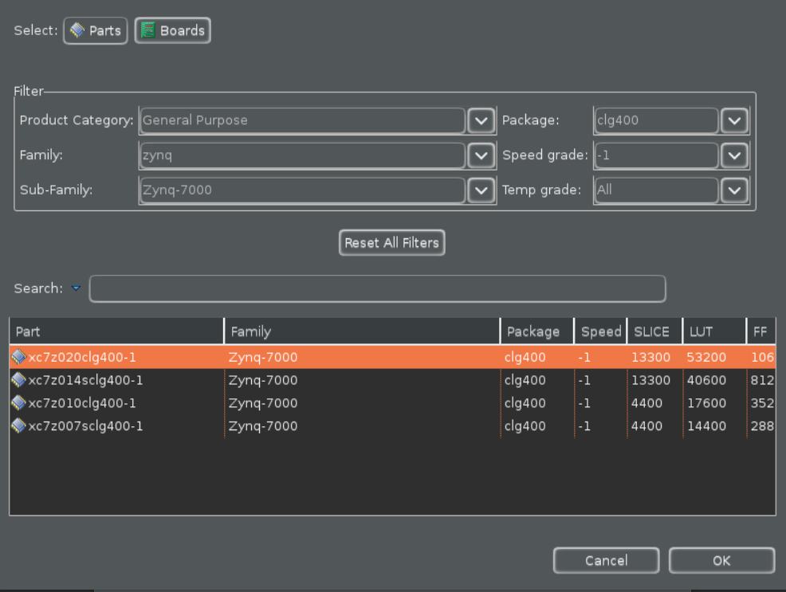
Selecting Part and Implementation Engine
Select the target part either through Parts or Boards specify

Slide 26
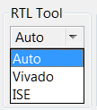
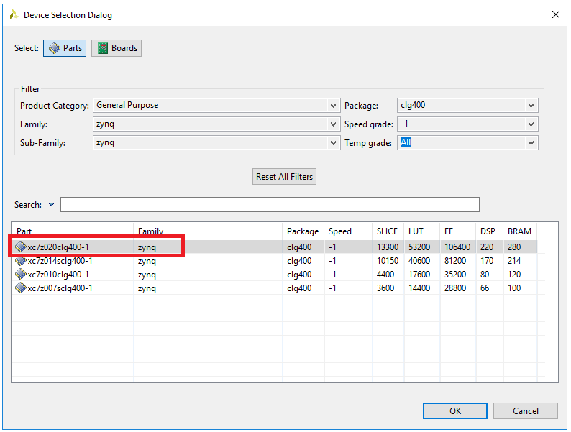
Selecting Part and Implementation Engine
Select the target part either through Parts or Boards specify
Select RTL Tools
Auto
Will select Vivado for 7 Series and Zynq devices
Will select ISE for Virtex-6 and earlier families
Vivado
ISE
ISE Design Suite must be installed and must be included in the PATH variable

Slide 27
Clock Specification
Clock frequency must be specified
Only 1 clock can be specified for C/C++ functions
Clock uncertainty can be specified
Subtracted from the clock period to give an effective clock period
The effective clock period is used for synthesis
Should not be used as a design parameter
Do not vary for different results: this is your safety margin
A user controllable margin to account for downstream RTL synthesis and P&R
Clock Period
Clock Uncertainty
Effective Clock Period
used by Vitis HLS
Margin for Logic Synthesis and P&R

Slide 28
A Vitis HLS Project
Project Explorer
Project files displayed in a hierarchal view
Auxiliary Pane
Cross-referenced with the Information Pane (here it shows objects in the source code)
Information Pane
Can view and edit any file from the Project Explorer
Console Pane
Displays Vitis HLS run time messages

Slide 29
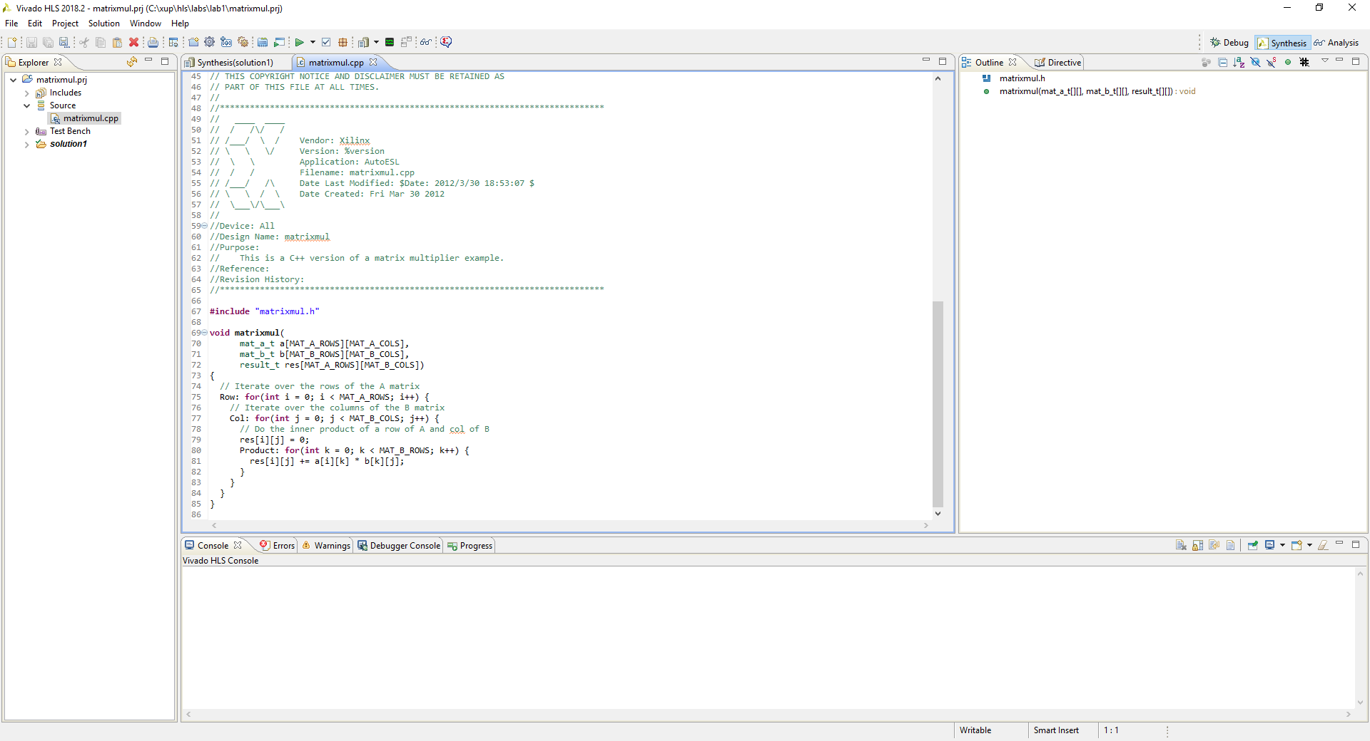
A Vivado HLS Project
Auxiliary Pane
Cross-referenced with the Information Pane (here it shows objects in the source code)
Project Explorer
Project files displayed in a hierarchal view
Information Pane
Can view and edit any file from the Project Explorer
Console Pane
Displays Vivado HLS run time messages

Slide 30

Vitis HLS GUI Toolbar
The primary commands have toolbar buttons
Easy access for standard tasks
Button highlights when the option is available
E.g. cannot perform C/RTL simulation before synthesis
Open a Project
Open Reports
Change Project Settings
Create a new Solution
Run C Simulation
Export RTL
Change Solution Settings
Run C/RTL Cosimulation
Open Schedule Viewer
Run C Synthesis

Slide 31

Vivado HLS GUI Toolbar
The primary commands have toolbar buttons
Easy access for standard tasks
Button highlights when the option is available
E.g. cannot perform C/RTL simulation before synthesis
Create a new Project
Open Analysis Viewer
Change Project Settings
Compare Reports
Create a new Solution
Open Reports
Export RTL
Change Solution Settings
Run C/RTL Cosimulation
Run C Simulation
Run C Synthesis

Slide 32
Files: Views, Edits & Information
Open file and it will display in the information pane
The Auxiliary pane is context sensitive with respect to the information pane
Here it displays elements in the code which can have directives specified on them

Slide 33
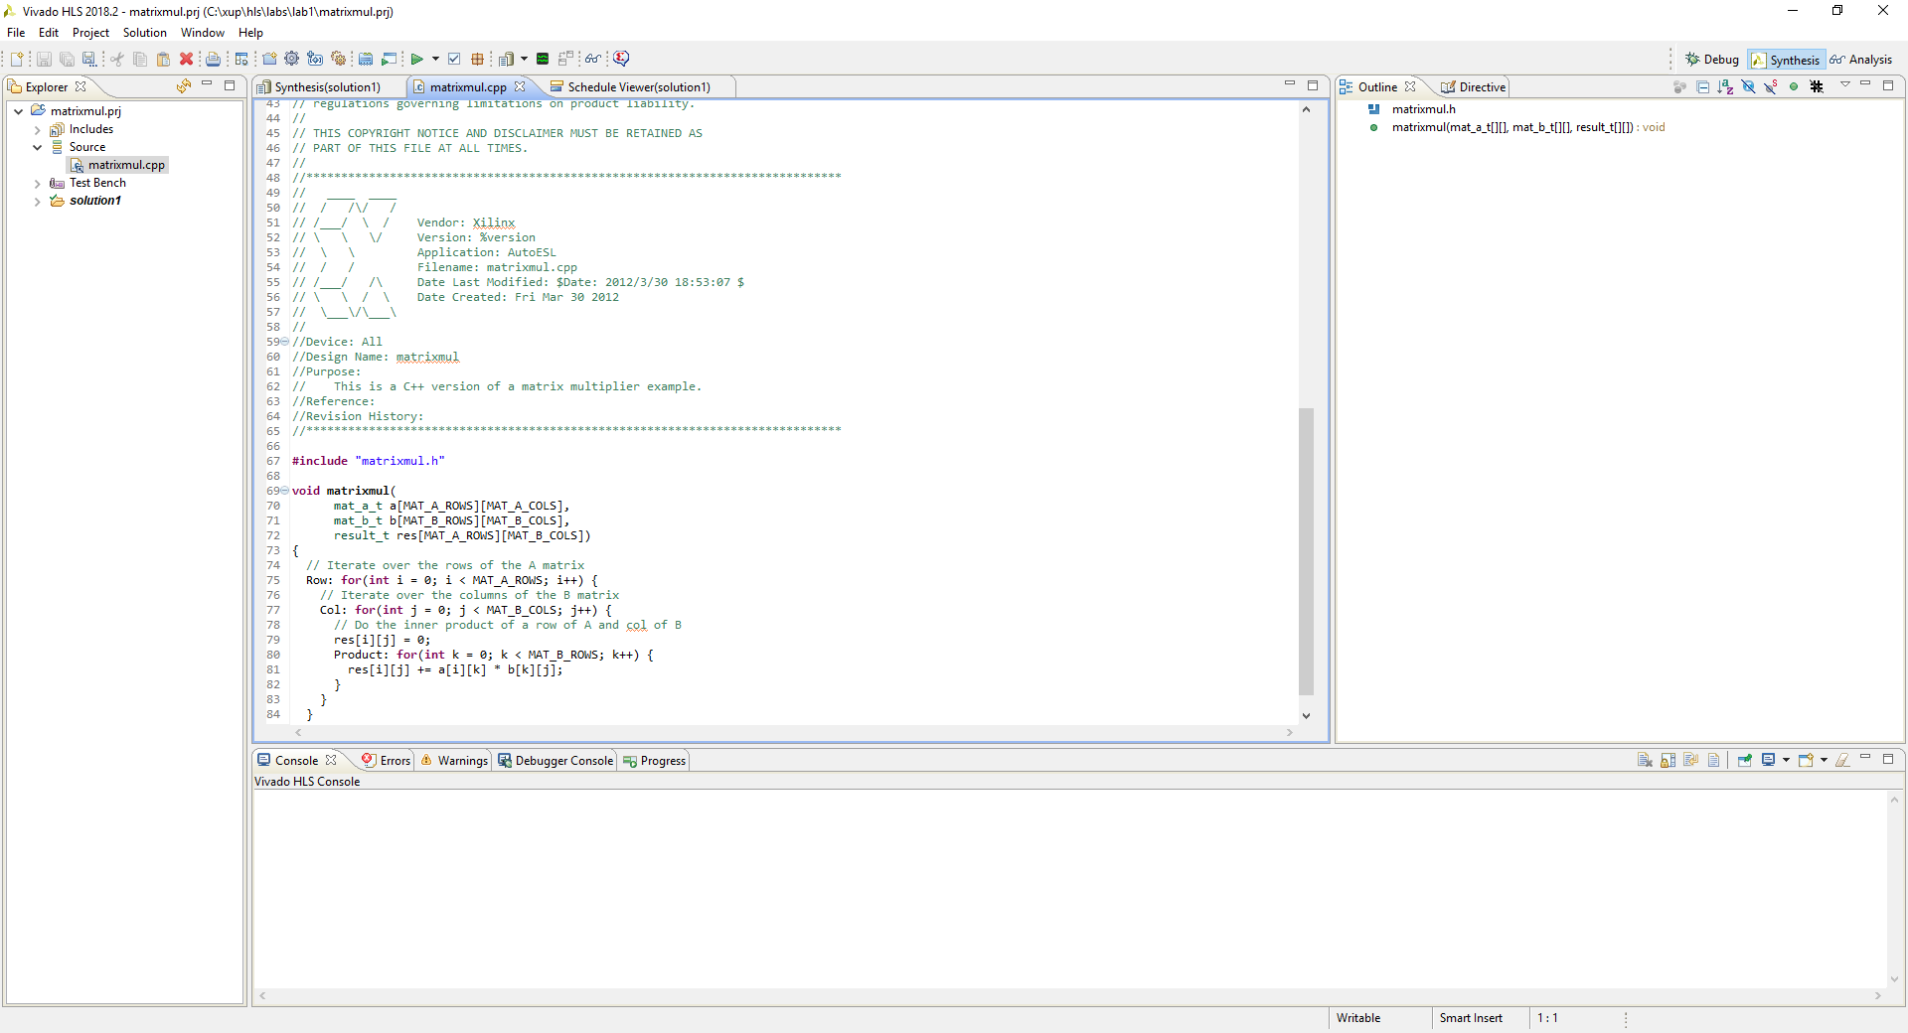
Files: Views, Edits & Information
Open file and it will display in the information pane
The Auxiliary pane is context sensitive with respect to the information pane
Here it displays elements in the code which can have directives specified on them

Slide 34
Synthesis to IPXACT Flow

Slide 35
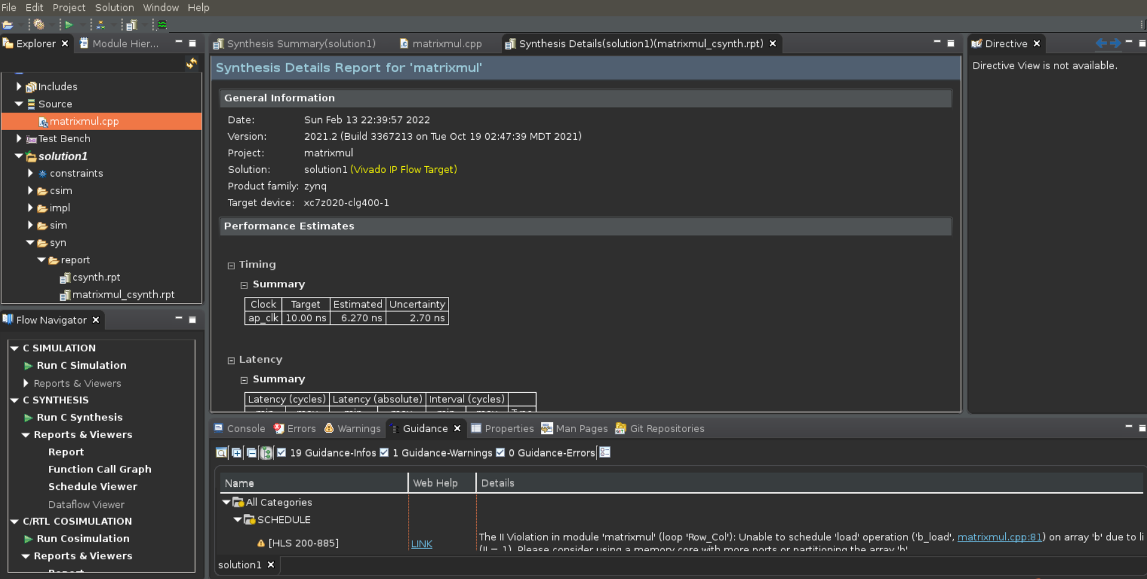
Synthesis
Run C Synthesis
Console
Will show run time information
Examine for failed constraints
A “syn” directory is created
Verilog & VHDL RTL
Synthesis reports for all non-inlined functions
Report opens automatically
When synthesis completes
Report is outlined in the Auxiliary pane

Slide 36
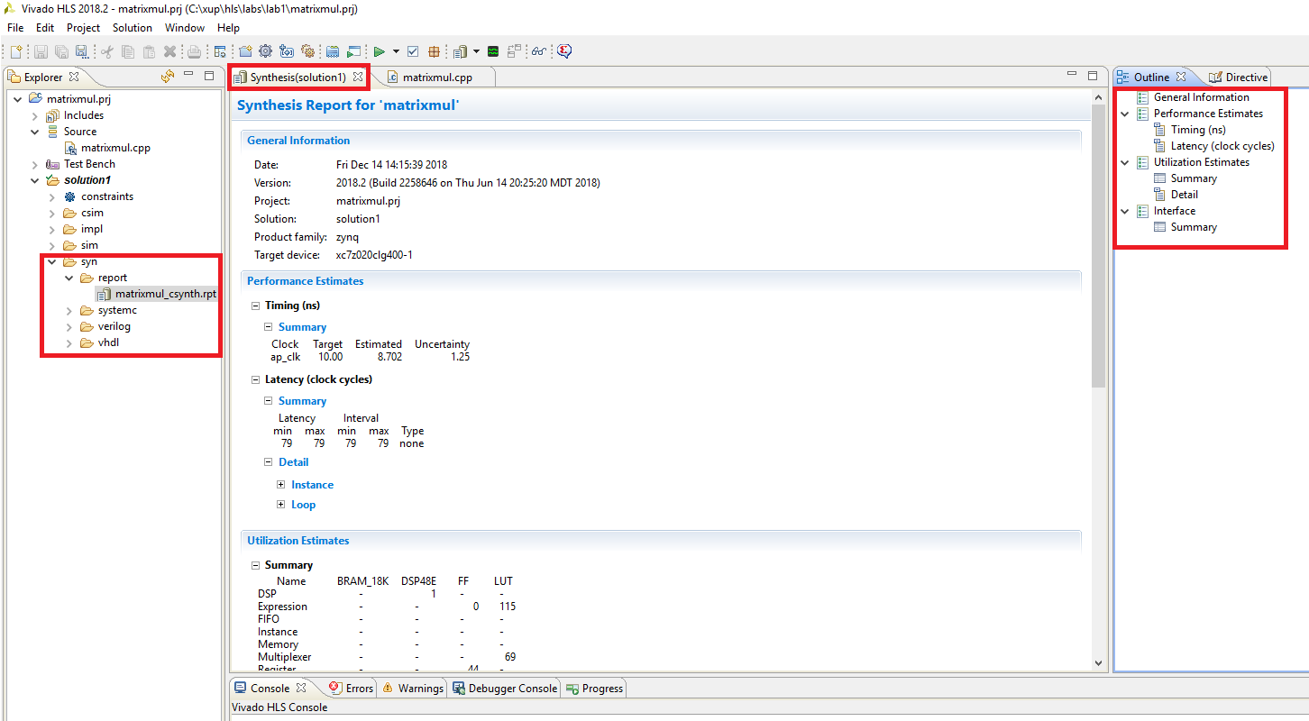
Synthesis
Run C Synthesis
Console
Will show run time information
Examine for failed constraints
A “syn” directory is created
Verilog, VHDL & SystemC RTL
Synthesis reports for all non-inlined functions
Report opens automatically
When synthesis completes
Report is outlined in the Auxiliary pane

Slide 37
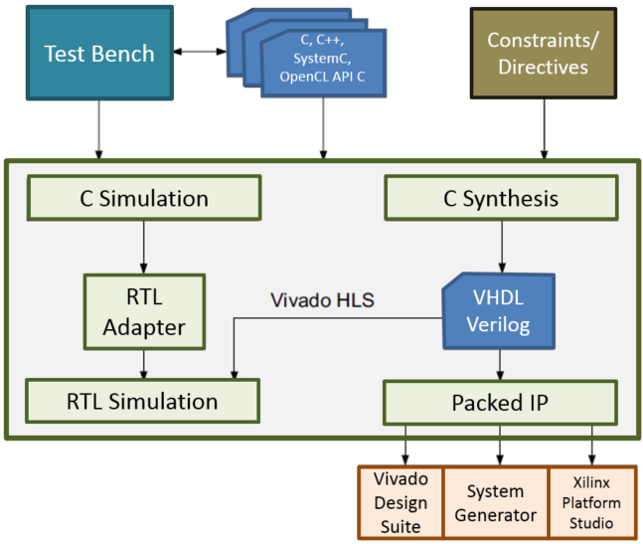
Vitis HLS : RTL Verification
RTL output in Verilog and VHDL
Automatic re-use of the C-level test bench
Validate C
Vitis
RTL verification can be executed from within Vitis HLS
Verify RTL
Support for Xilinx simulators (XSim and ISim) and 3rd party HDL simulators in automated flow
Vitis Development
Environment
Vitis Model Composer

Slide 38
RTL Verification: Under-the-Hood
RTL Co-Simulation
Vitis HLS provides RTL verification
Creates the wrappers and adapters to re-use the C test bench
main.c(pp)
main.c(pp)
Adapter
DUT wrapper
Adapter
dut.c(pp)
Synthesis
RTL
Prior to synthesis
Test bench
Top-level C function
After synthesis
Test bench
Wrapper created by Vitis HLS
Adapters created by Vitis HLS
RTL output from Vitis HLS
Verilog or VHDL
There is no HDL test bench created
12- 38

Slide 39
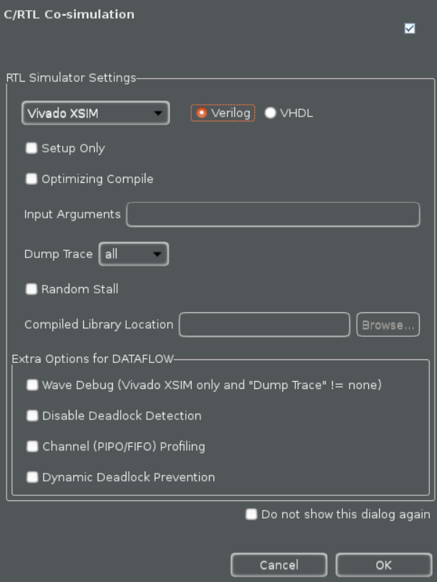
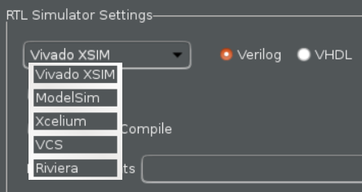
C/RTL Co-simulation
Start Simulation
Opens the dialog box
Select the RTL
Verilog and VHDL require the appropriate simulator
Select the desired simulator
Options
Can output trace file (VCD format)
Optimize the C compilation & specify test bench linker flags
The “setup only” option will not execute the simulation
OK will run the simulator
Output files will be created in a “sim” directory

Slide 40
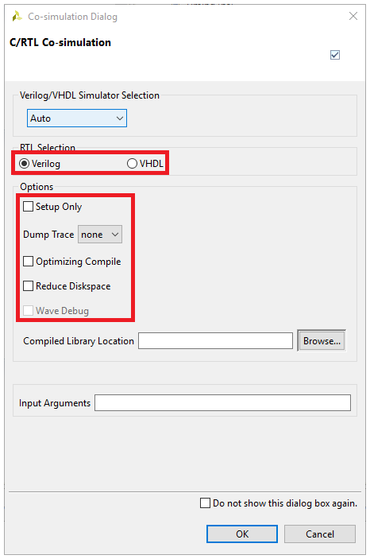
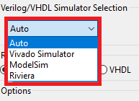
C/RTL Co-simulation
Start Simulation
Opens the dialog box
Select the RTL
Verilog and VHDL require the appropriate simulator
Select the desired simulator
Options
Can output trace file (VCD format)
Optimize the C compilation & specify test bench linker flags
The “setup only” option will not execute the simulation
OK will run the simulator
Output files will be created in a “sim” directory

Slide 41
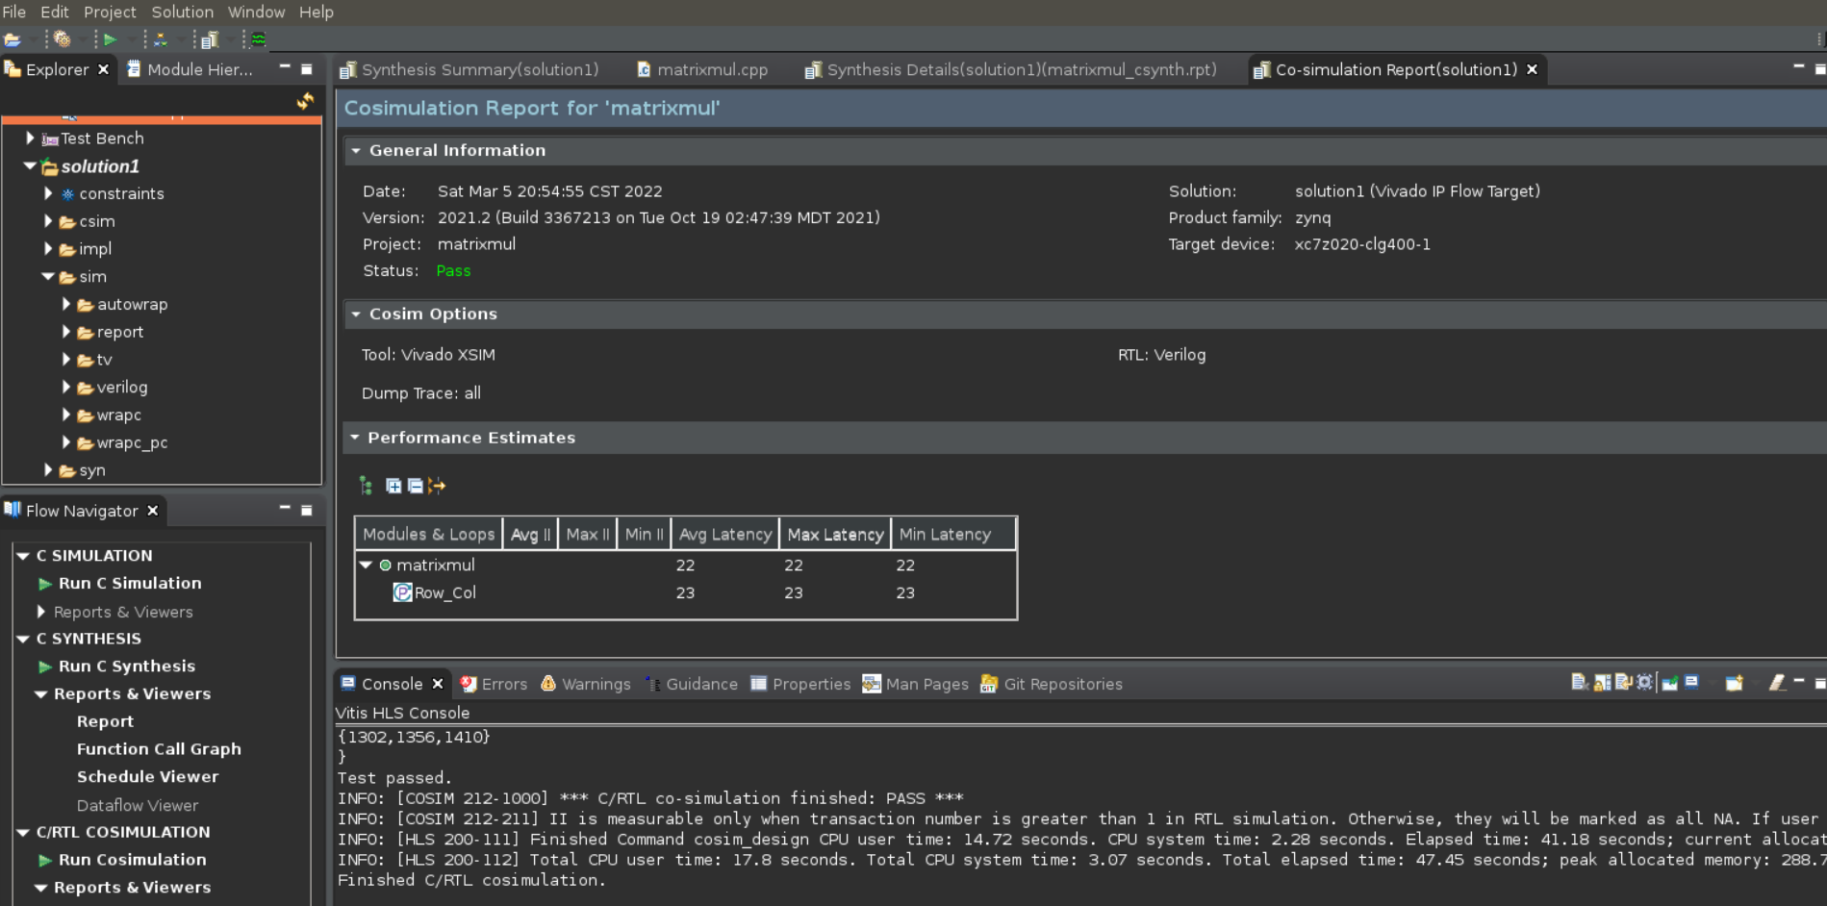
Simulation Results
Simulation output is shown in the console
Expect the same test bench response
If the C test bench plots, it will with the RTL design (but slower)
Sim Directory
Will contain a sub-directory for each RTL which is verified
Report
A report is created and opened automatically

Slide 42
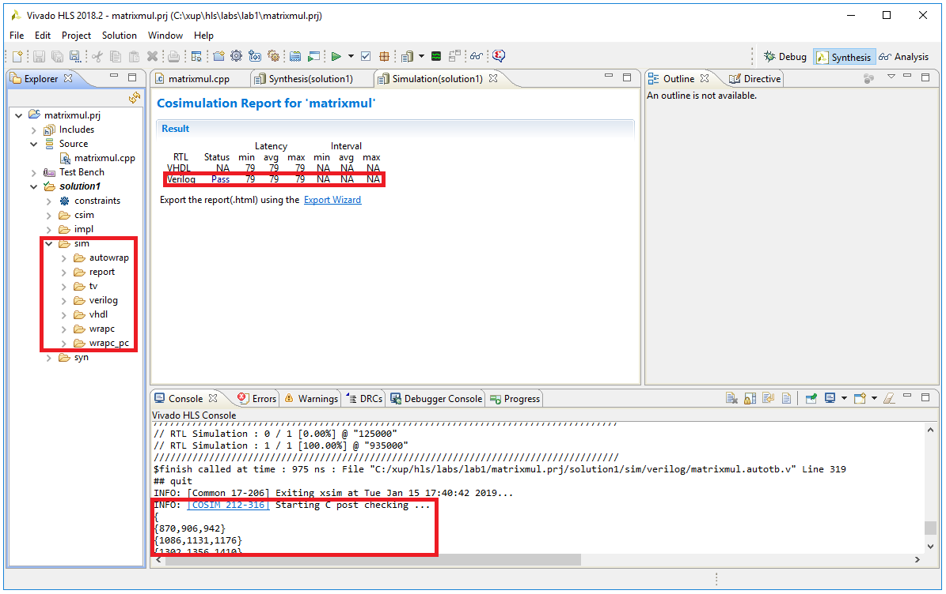
Simulation Results
Simulation output is shown in the console
Expect the same test bench response
If the C test bench plots, it will with the RTL design (but slower)
Sim Directory
Will contain a sub-directory for each RTL which is verified
Report
A report is created and opened automatically

Slide 43
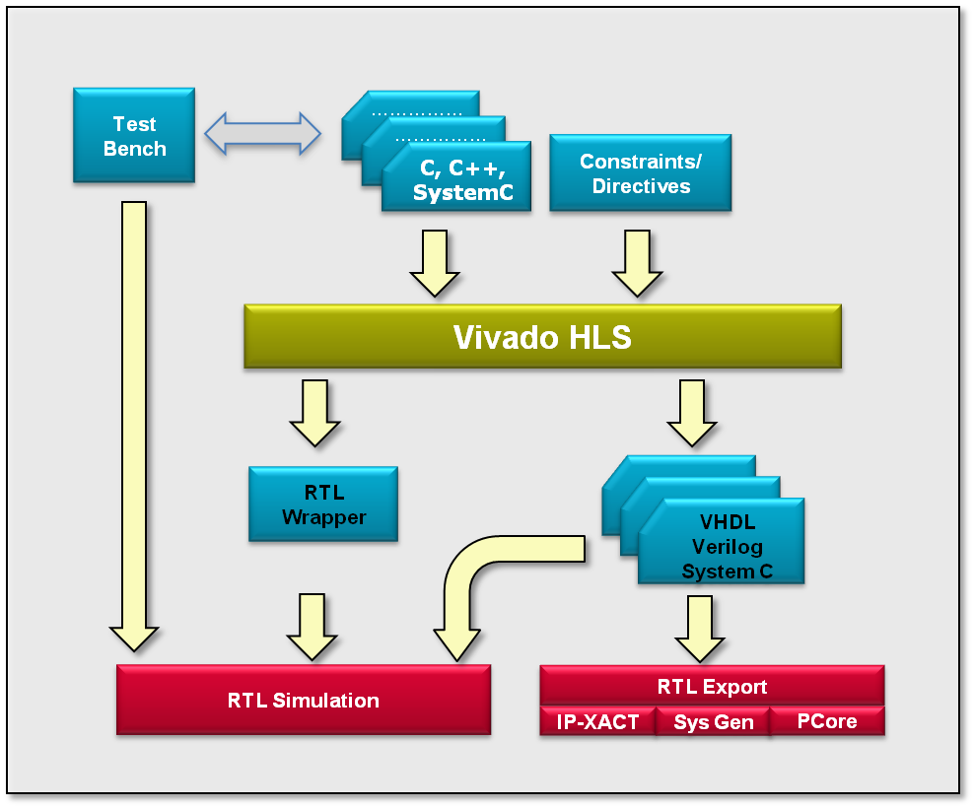
Vitis HLS : RTL Export
RTL output in Verilog, VHDL
Scripts created for RTL synthesis tools
Vitis
RTL Export to IP-XACT, SysGen, and Pcore formats
IP-XACT and SysGen => Vitis HLS for 7 Series and Zynq families
PCore => Only Vitis HLS Standalone for all families

Slide 44
Vivado HLS : RTL Export
RTL output in Verilog, VHDL and SystemC
Scripts created for RTL synthesis tools
RTL Export to IP-XACT, SysGen, and Pcore formats
IP-XACT and SysGen => Vivado HLS for 7 Series and Zynq families
PCore => Only Vivado HLS Standalone for all families

Slide 45
RTL Export Support
RTL Export
Can be exported to one of the two types
IP-XACT formatted IP for use with Vitis System Edition (SE)
7 Series and Zynq families only; supported by HLS and VITIS_HLS licenses
A System Generator IP block
7 Series and Zynq families only; supported by HLS and VITIS_HLS licenses
Generation in both Verilog and VHDL for non-bus or non-interface based designs
Logic synthesis will automatically be performed
HLS license will use Vitis RTL Synthesis
12- 45

Slide 46
RTL Export: Synthesis
project.prj
impl
verilog
vhdl
sim
solutionN
solution1
ip
sysgen
syn
RTL Synthesis can be performed to evaluate the RTL
IP-XACT and System Generator formats: Vitis synthesis performed
Pcore format: Vitis synthesis is performed
RTL synthesis results are not included with the IP package
Evaluate step is provided to give confidence
Timing will be as estimate (or better)
Area will be as estimated (or better)
Final RTL IP is synthesized with the rest of the RTL design
RTL Synthesis results from the Vitis HLS evaluation are not used
RTL Synthesis Results
IP Repositories

Slide 47
RTL Export: IP Repositories
IP can be imported into other Xilinx tools
Project Directory
Top-level project directory
(there must be one)
Solution directories
There can be multiple solutions for each project. Each solution is a different implementation of the same (project) source code
project.prj
impl
sim
solutionN
solution1
ip
sysgen
syn
In Vitis :
Project Manager > IP Catalog
Add IP to import this block
Browse to the zip file inside “ip”
In System Generator :
Use XilinxBlockAdd
Select Vitis_HLS block type
Browse to the solution directory

Slide 48
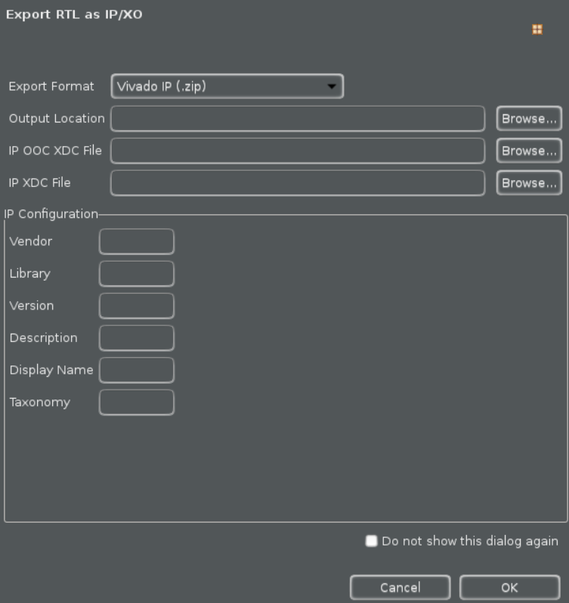
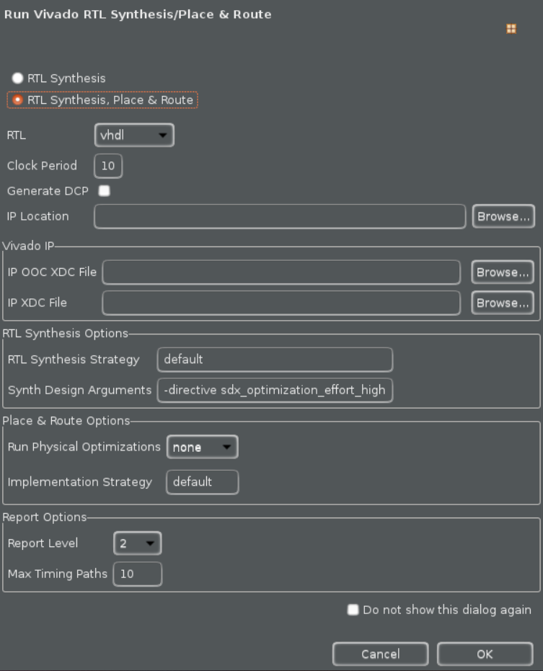
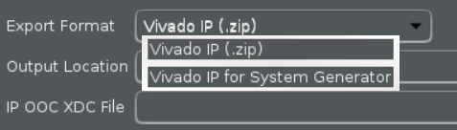
RTL Export for Implementation
Click on Export RTL
Export RTL Dialog opens
Select the desired output format
Optionally, configure the output
Select the desired language
Optionally, click on implementation and choose RTL Synthesis, Place & Route options for invoking implementation tools from within Vitis HLS
Click OK to start the implementation

Slide 49
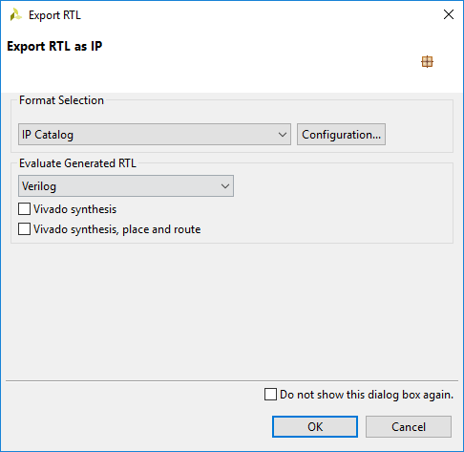
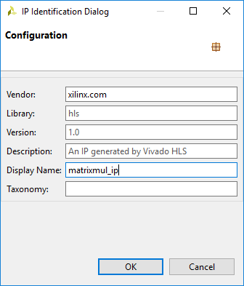
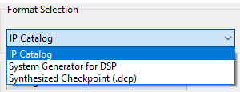
RTL Export for Implementation
Click on Export RTL
Export RTL Dialog opens
Select the desired output format
Optionally, configure the output
Select the desired language
Optionally, click on Vivado RTL Synthesis and Place and Route options for invoking implementation tools from within Vivado HLS
Click OK to start the implementation

Slide 50
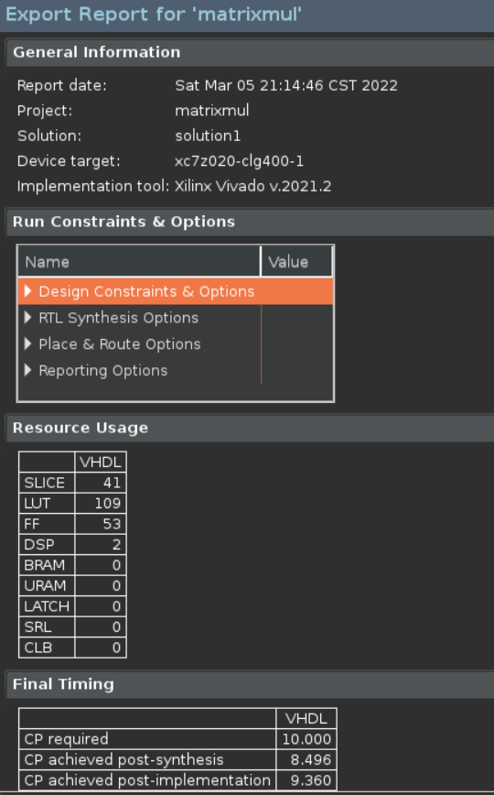
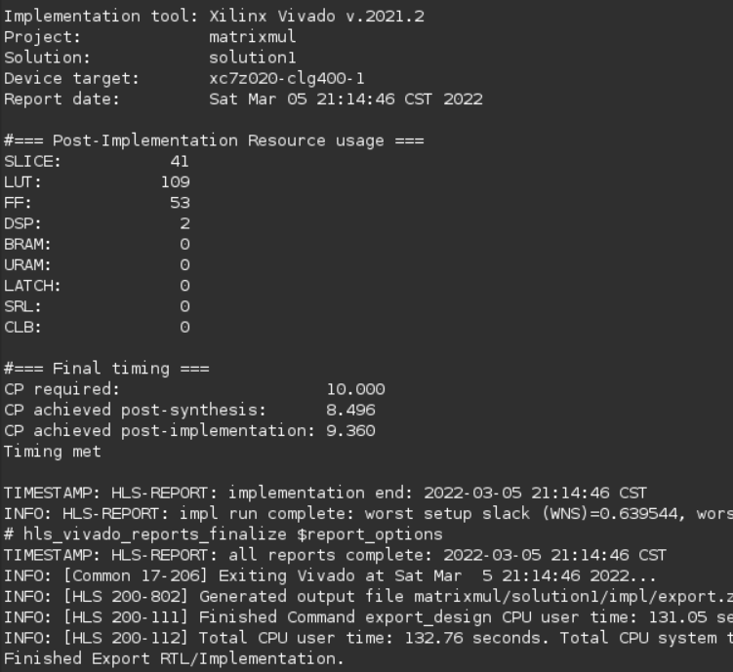
RTL Export (Place and Route Option) Results
Impl directory created
Will contain a sub-directory for each RTL which is synthesized
Report
A report is created and opened automatically

Slide 51
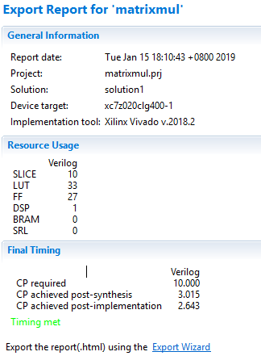
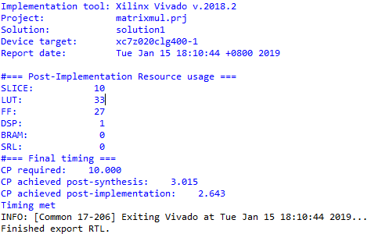
RTL Export (Place and Route Option) Results
Impl directory created
Will contain a sub-directory for each RTL which is synthesized
Report
A report is created and opened automatically

Slide 52
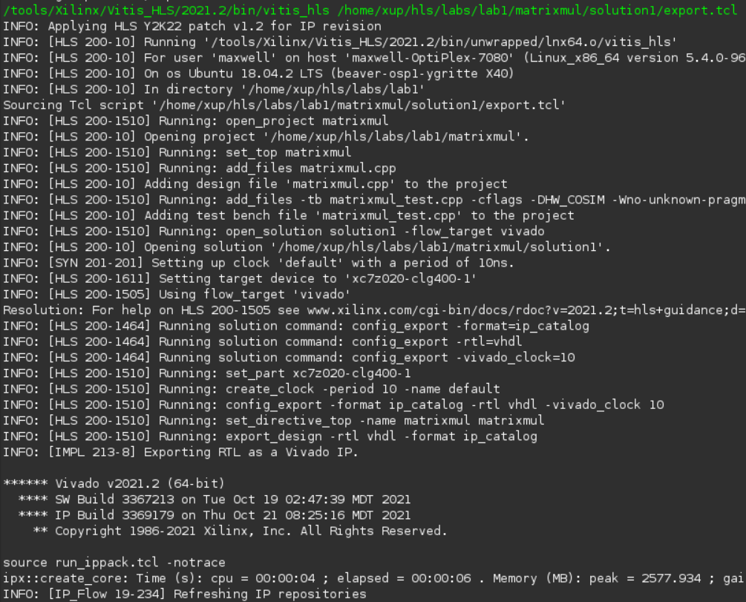

RTL Export Results (Place and Route Option Unchecked)
Impl directory created
Will contain a sub-directory for both VHDL and Verilog along with the ip directory
No report will be created
Observe the console
No packing, routing phases

Slide 53

RTL Export Results (Place and Route Option Unchecked)
Impl directory created
Will contain a sub-directory for both VHDL and Verilog along with the ip directory
No report will be created
Observe the console
No packing, routing phases

Slide 54
Design Analysis

Slide 55




Analysis Perspective
Perspective for design analysis
Allows interactive analysis

Slide 56

Performance Analysis

Slide 57

Performance Analysis

Slide 58



Resources Analysis

Slide 59

Resources Analysis

Slide 60

Function Call Graph

Slide 61
Other Ways to use Vitis HLS

Slide 62


Command Line Interface: Batch Mode
Vivado HLS can also be run in batch mode
Opening the Command Line Interface (CLI) will give a shell
Supports the commands required to run Vivado HLS & pre-synthesis verification (gcc, g++, apcc, make)
12- 62

Slide 63
Using Vitis HLS CLI
Invoke Vitis HLS in interactive mode
Type Tcl commands one at a time
Execute Vitis HLS using a Tcl batch file
Allows multiple runs to be scripted and automated
Open an existing project in the GUI
For analysis, further work or to modify it
Use the terminal to launch Vitis HLS GUI
> vitis_hls –i
> vitis_hls –f run_aesl.tcl
> vitis_hls –p my.prj
> vitis_hls
12- 63

Slide 64

Using Tcl Commands
When the project is created
All Tcl command to run the project are created in script.tcl
User specified directives are placed in directives.tcl
Use this as a template from creating Tcl scripts

Slide 65

Using Tcl Commands
When the project is created
All Tcl command to run the project are created in script.tcl
User specified directives are placed in directives.tcl
Use this as a template from creating Tcl scripts
Uncomment the commands before running the Tcl script

Slide 66



Help
Help is always available
The Help Menu
Opens User Guide, Reference Guide and Man Pages
In interactive mode
The help command lists the man page for all commands
Auto-Complete all commands using the tab key

Slide 67


Help
Help is always available
The Help Menu
Opens User Guide, Reference Guide and Man Pages
In interactive mode
The help command lists the man page for all commands
Vivado_hls> help add_files
SYNOPSIS
add_files [OPTIONS] <src_files>
Etc…
Auto-Complete all commands using the tab key

Slide 68
Summary

Slide 69
Summary
Vitis HLS can be run under Windows 10, Red Hat Linux, Cent OS, and Ubuntu
Vitis HLS can be invoked through GUI and command line in Windows OS, and command line in Linux
Vitis HLS project creation wizard involves
Defining project name and location
Adding design files
Specifying testbench files
Selecting clock and technology
The top-level module in testbench is main() whereas top-level module in the design is the function to be synthesized
12- 69

Slide 70
Summary
Vivado HLS can be run under Windows 7/8.1/10, Red Hat Linux, SUSE OS, and Ubuntu
Vivado HLS can be invoked through GUI and command line in Windows OS, and command line in Linux
Vivado HLS project creation wizard involves
Defining project name and location
Adding design files
Specifying testbench files
Selecting clock and technology
The top-level module in testbench is main() whereas top-level module in the design is the function to be synthesized
12- 70

Slide 71
Summary
Vitis HLS project directory consists of
*.prj project file
Multiple solutions directories
Each solution directory may contain
impl, synth, and sim directories
The impl directory consists of ip, verilog, and vhdl folders
The synth directory consists of reports, vhdl, and verilog folders
The sim directory consists of testbench and simulation files

